Slide 1
Bivariate assessment
By
MuthuKumaran

Slide 2
Replace the NaN values with correct value. And justify why you have chosen the same
The reason was according to dataset they not getting salary so in that place NAN was there so we have replace in that place zero.

Slide 3
2)How many of them are not placed
64 was not placed

Slide 4
3)Find the reason for non placement from the dataset?
Because they not getting salary

Slide 5
4)What kind of relation between salary and mba
df.select_dtypes(include='number')[['mba_p', 'salary']].corr()
High positive MBA score strongly affects salary
Low Weak or no impact

Slide 6
Which specialization is getting minimum salary dataset[quan].min()
sl_no 1.00
ssc_p 40.89
hsc_p 37.00
degree_p 50.00
etest_p 50.00
mba_p 51.21
salary 200000.00
dtype: float64
If we check with quan we can get this max sal

Slide 7
How many of them getting above 500000 salary?
count = (dataset['salary'] > 500000).sum()
print("Number of salaries above 5,00,000:",count) In dataset greater than sal 500000 id we sum we can get count 3 member are geting

Slide 8
7)Test the Analysis of Variance between etest_p and mba_p at signifance
level 5%.(Make decision using Hypothesis Testing)
from scipy.stats import ttest_ind
t_stat, p_value = ttest_ind(df['etest_p'], df['mba_p'])
print(f_stat)
print(p_value)
fail to reject the null hypothesis. P Value is more

Slide 9
8)Test the similarity between the degree_t(Sci&Tech) and specialisa-
ion(Mkt&HR) with respect to salary at significance level of 5%.(Make
decision using Hypothesis Testing
from scipy.stats import ttest_ind
dataset=dataset.dropna()
degree=dataset[dataset['degree_t']=='Sci&Tech']["salary"]
specialisation=dataset[dataset['specialisation']=='Mkt&HR']["salary"]
ttest_ind(degree,specialisation)
reject the null hypothesis. By checking the Pvalue

Slide 10
9)Convert the normal distribution to standard normal distribution for
salary column convertion of Normal distribution to Standed Normal distribution graph.
def stand_nor_dist(df):
import seaborn as sns #importing requid moduel
mean=df.mean() # finding mean with dataset
std =df.std() # finding std with dataset
values=[i for i in df] # passing dataset in list by useing for loop storeing in values
z_score=[((s-mean)/std)for s in values] #passing Normal SD formula in the Values list by useing for loop storeing in z_score
sns.displot(z_score,kde=True) # Creating graph by list stored z_score ### Z_score is formula name to find SND
sum(z_score)/len(z_score) # sumation

Slide 11
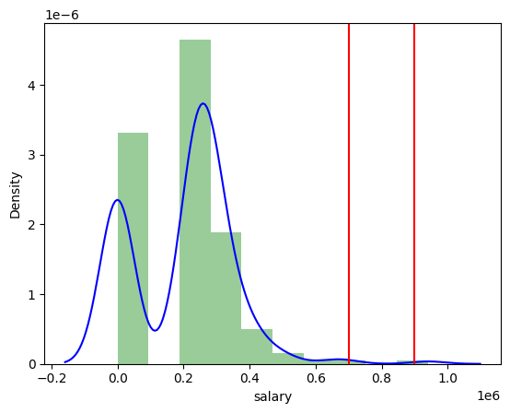
)What is the probability Density Function of the salary range from
700000 to 900000?
If we place in graph we get the PDF
Below will place the graph

Slide 12
12)Which parameter is highly correlated with salary?
df[quan].corr()['salary']
Ssc pis the most highly correlated parameter with salary
sl_no 0.002543

Slide 13
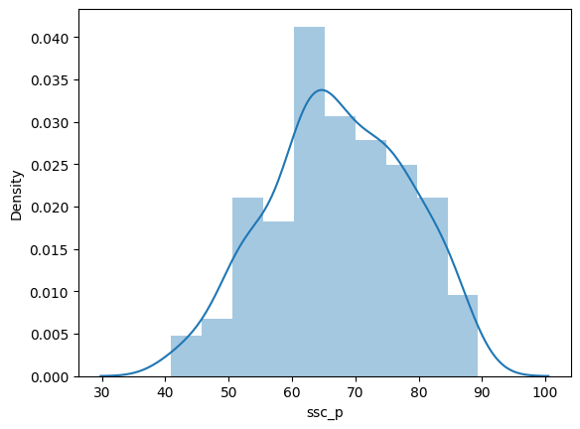
plot any useful graph and explain it.
import seaborn as sns
sns.distplot(df["ssc_p"])
The graph is about the SSC passing percentage for a normal density curve. The range of 30 to 100 density was up to 0.040. The cure started at 30, ended at 100, and the peak went up to 0.031; the inside bar went up to 0.040

